Slide 1
Manifold Learning Methods Comparison for Ordering Heads Direction - CSIC5011 2019 Spring Project2
Di LIU, Meilan WANG, Xu HAN

Slide 2
Outline
Introduction
Dataset
Methods
Performance Evaluation
Conclusion and Further work
Reference

Slide 3
Introduction
Face Pose Determination
Model-based estimation methods (3D model rebuild)
Face property-based (or appearance-based) estimation methods (learn from 2D data)
Manifold learning methods contribute to appearance-based methods so as to order head directions.

Slide 4
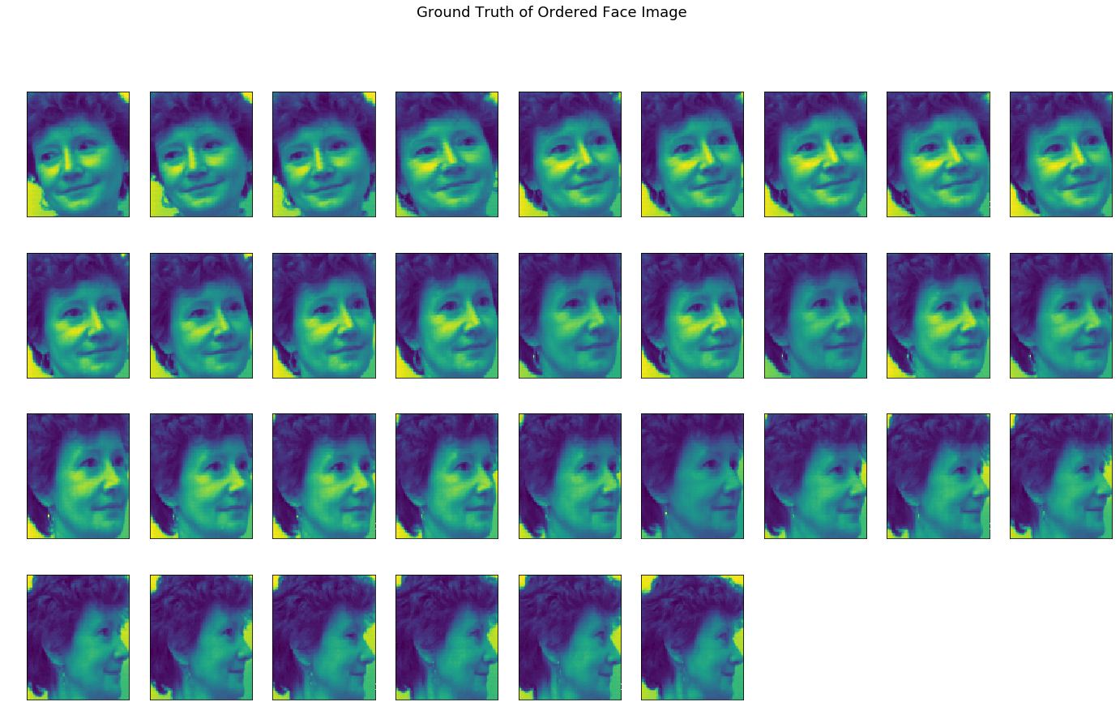
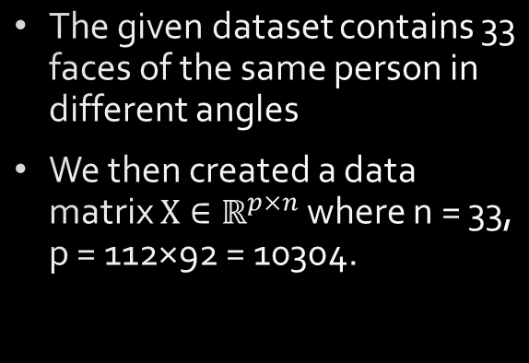
Dataset
Ground Truth of Ordered Face Image
The given dataset contains 33 faces of the same person in different angles
We then created a data matrix $X∈ℝ^{p×n}$where n = 33, p = 112×92 = 10304.

Slide 5
Methods
Methods Comparison
Multi-Dimensional Scaling (MDS)
ISOMAP
Locally Linear Embedding (LLE)
Local Tangent Space Alignment (LTSA)
Modiﬁed LLE (MLLE)
Hessian LLE (HLLE)
Diffusion Map
t- distributed Stochastic Neighbor Embedding (t-SNE)
Hyper-parameter Test
Number of neighbors (from 5 to 10)
6 methods (ISOMAP, LLE, MLLE, HLLE, LTSA and Diffusion Map)

Slide 6
Performance Evaluation
Performance Evaluation Metrics
Original# | 1 | 2 | 3 | … | 32 | 33
Ground Truth Position | 8 | 13 | 19 | … | 25 | 9
Diffusion Map Position | 9 | 11 | 19 | … | 25 | 8
Absolute Error | 1 | 2 | 0 | … | 0 | 1
The performance evaluation metrics of all the methods
Original# | TAE | 1 | 2 | 3 | 4 | 5 | 6 | 7 | 8 | 9 | 10 | 11 | 12 | 13 | 14 | 15 | 16 | 17 | 18 | 19 | 20 | 21 | 22 | 23 | 24 | 25 | 26 | 27 | 28 | 29 | 30 | 31 | 32 | 33
Ground Truth Position |  | 8 | 13 | 19 | 32 | 6 | 18 | 28 | 7 | 17 | 1 | 5 | 16 | 12 | 10 | 4 | 21 | 22 | 26 | 33 | 11 | 2 | 24 | 3 | 27 | 29 | 23 | 15 | 30 | 31 | 20 | 14 | 25 | 9
Diffusion Map Position | 20 | 9 | 11 | 19 | 31 | 5 | 18 | 28 | 6 | 17 | 1 | 7 | 16 | 12 | 10 | 4 | 21 | 22 | 26 | 33 | 13 | 2 | 23 | 3 | 27 | 30 | 24 | 14 | 32 | 29 | 20 | 15 | 25 | 8
MDS Position | 30 | 9 | 10 | 19 | 32 | 5 | 18 | 30 | 6 | 17 | 1 | 7 | 16 | 12 | 11 | 4 | 21 | 22 | 26 | 28 | 13 | 2 | 23 | 3 | 27 | 31 | 24 | 14 | 33 | 29 | 20 | 15 | 25 | 8
ISOMAP Position | 10 | 7 | 13 | 19 | 32 | 5 | 18 | 28 | 10 | 17 | 1 | 6 | 16 | 12 | 9 | 4 | 21 | 22 | 26 | 33 | 11 | 2 | 24 | 3 | 27 | 29 | 23 | 14 | 30 | 31 | 20 | 15 | 25 | 8
LLE Position | 6 | 8 | 13 | 19 | 32 | 5 | 18 | 28 | 7 | 17 | 1 | 6 | 16 | 12 | 10 | 4 | 21 | 22 | 26 | 33 | 11 | 2 | 23 | 3 | 27 | 29 | 24 | 14 | 30 | 31 | 20 | 15 | 25 | 9
Modified LLE Position | 10 | 8 | 12 | 19 | 32 | 6 | 18 | 28 | 7 | 17 | 1 | 5 | 16 | 11 | 10 | 4 | 21 | 22 | 26 | 33 | 13 | 2 | 23 | 3 | 27 | 29 | 24 | 14 | 31 | 30 | 20 | 15 | 25 | 9
Hessian LLE Position | 8 | 8 | 13 | 19 | 32 | 6 | 18 | 28 | 7 | 17 | 2 | 5 | 16 | 12 | 10 | 4 | 21 | 22 | 26 | 33 | 11 | 1 | 23 | 3 | 27 | 29 | 24 | 14 | 31 | 30 | 20 | 15 | 25 | 9
Spectrum embedding Position | 12 | 6 | 13 | 18 | 32 | 8 | 19 | 28 | 7 | 17 | 3 | 5 | 16 | 12 | 10 | 4 | 21 | 22 | 26 | 33 | 11 | 2 | 24 | 1 | 27 | 29 | 23 | 14 | 30 | 31 | 20 | 15 | 25 | 9
LTSA Position | 8 | 8 | 13 | 19 | 32 | 6 | 18 | 28 | 7 | 17 | 2 | 5 | 16 | 12 | 10 | 4 | 21 | 22 | 26 | 33 | 11 | 1 | 23 | 3 | 27 | 29 | 24 | 14 | 31 | 30 | 20 | 15 | 25 | 9
t-SNE Position | 164 | 8 | 12 | 20 | 30 | 14 | 22 | 23 | 10 | 17 | 1 | 18 | 16 | 5 | 2 | 6 | 9 | 33 | 25 | 24 | 27 | 15 | 11 | 4 | 32 | 29 | 21 | 19 | 28 | 31 | 13 | 7 | 26 | 3

Slide 7
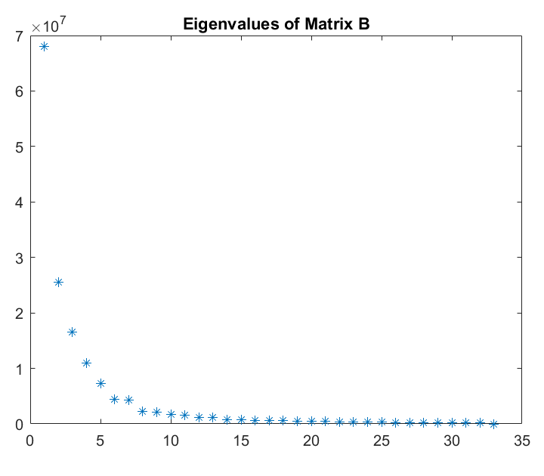
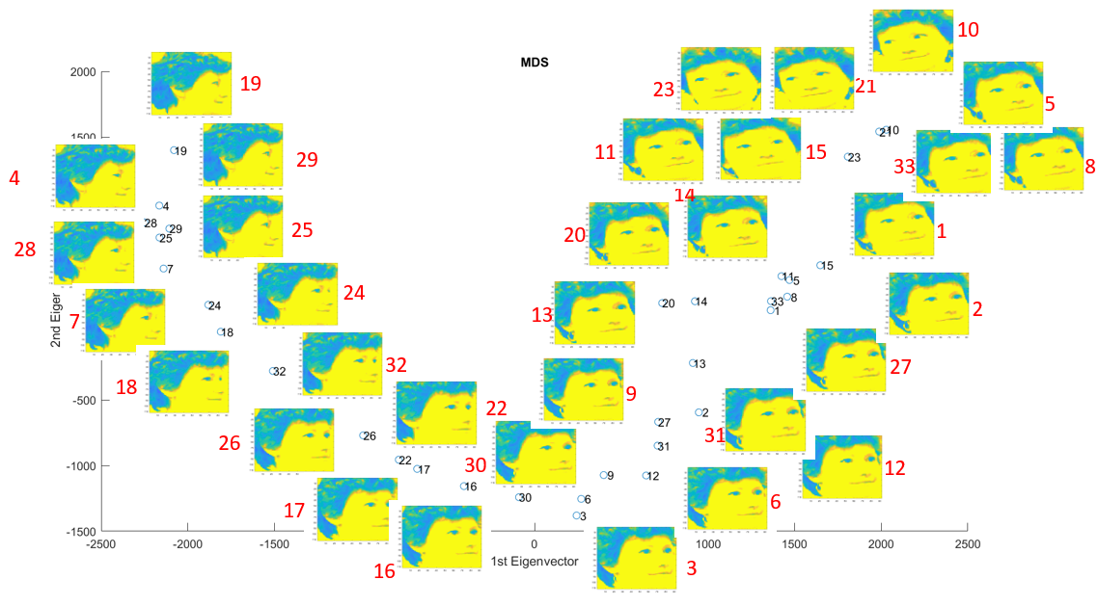
Results of MDS
Explained variance as a function of number of components in MDS
2D embedding graph

Slide 8
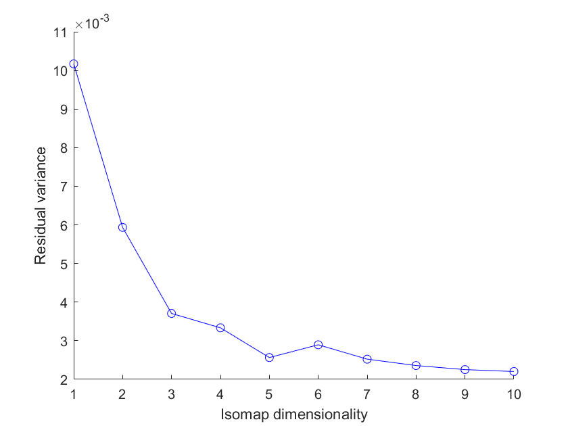
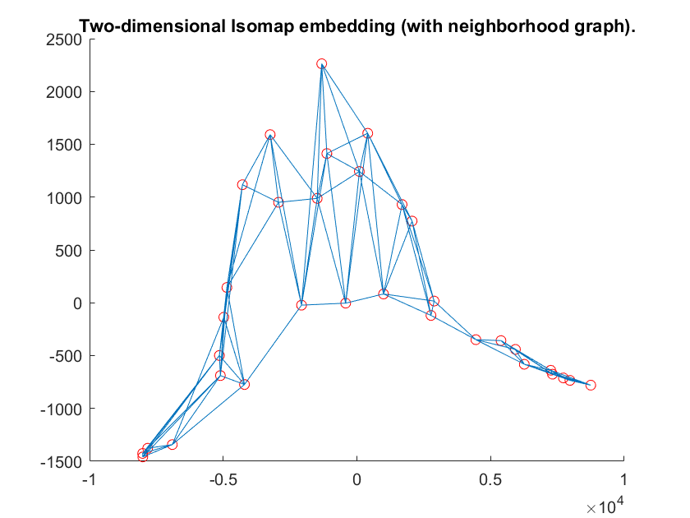
Results of ISOMAP
Residual variance as a function of number of components in ISOMAP
2D embedding graph

Slide 9
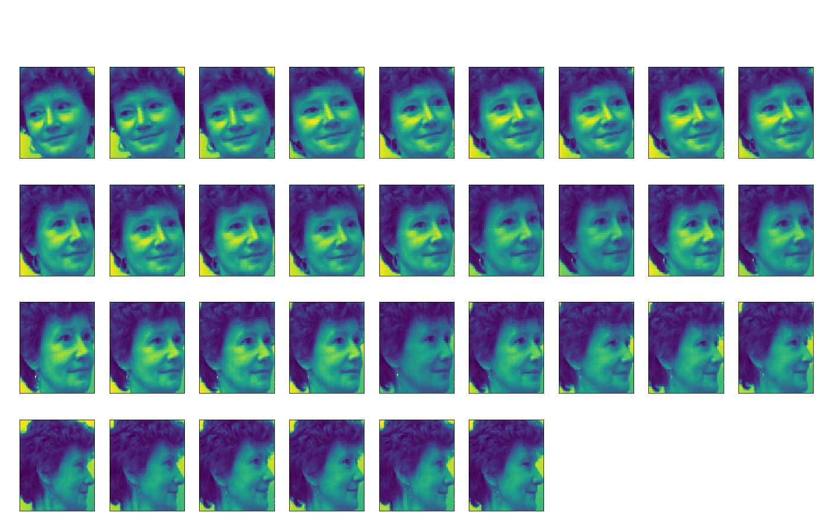
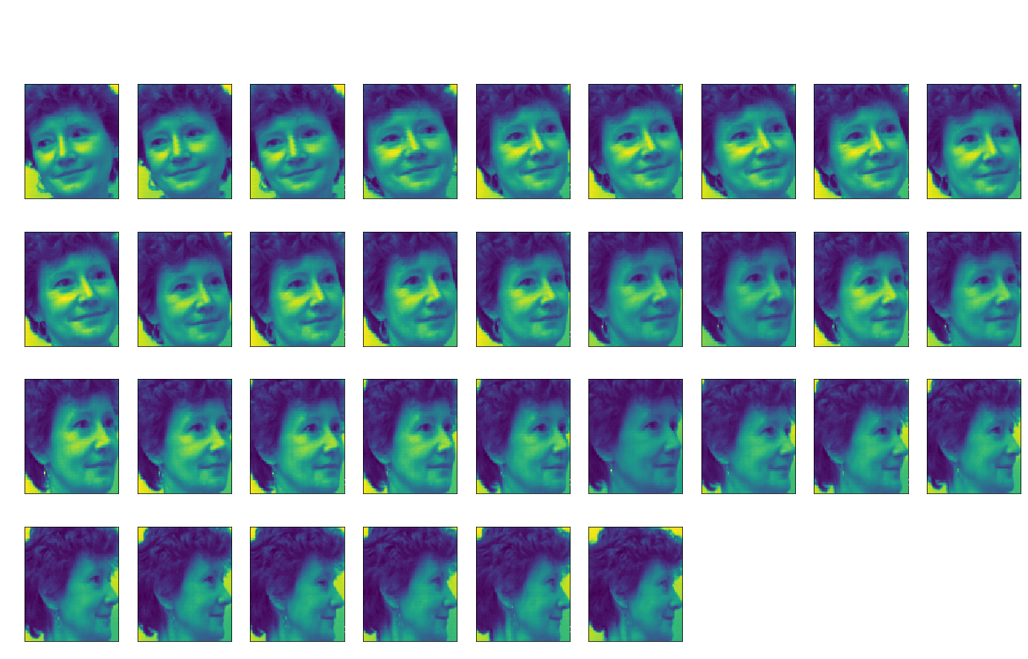
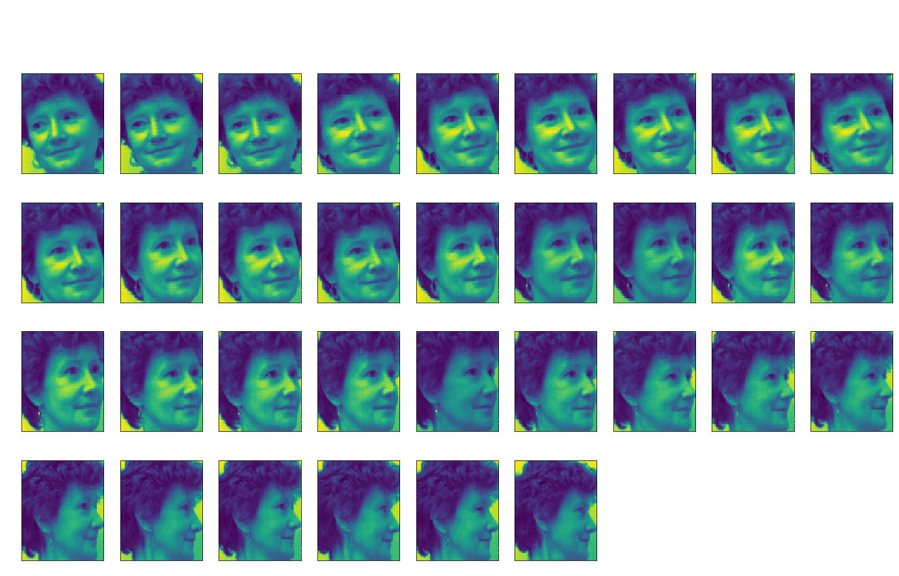
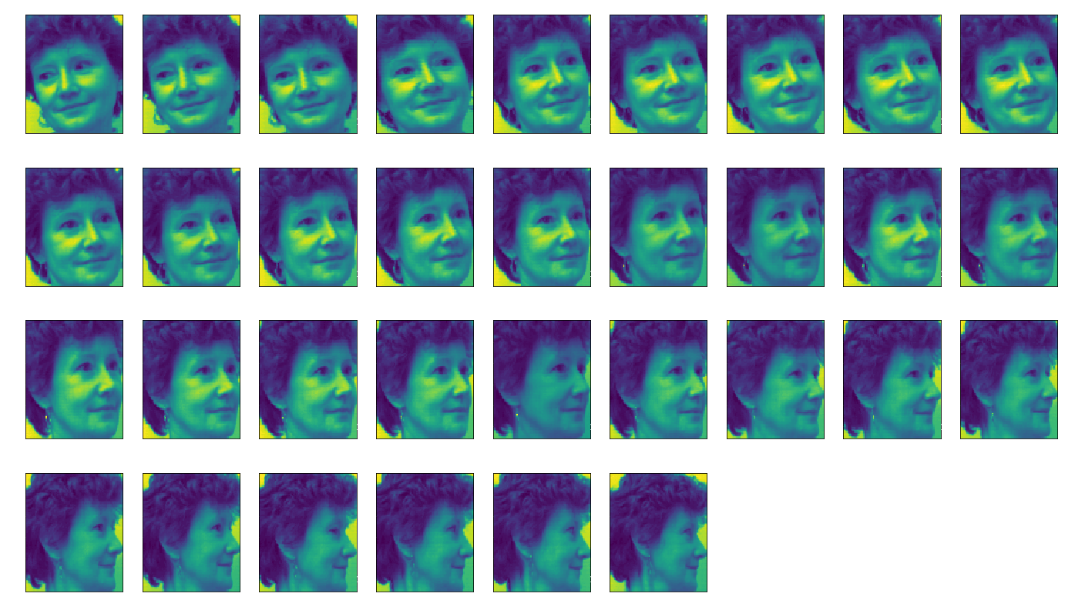
Visualization of Results
MDS
ISOMAP
Diffusion Map
LLE

Slide 10
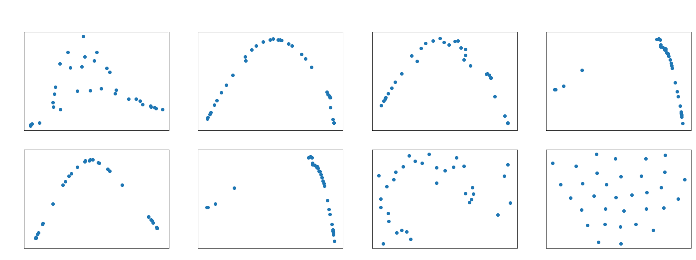
Results Comparison
Manifold Learning with 2 components, 5 neighbors

Slide 11
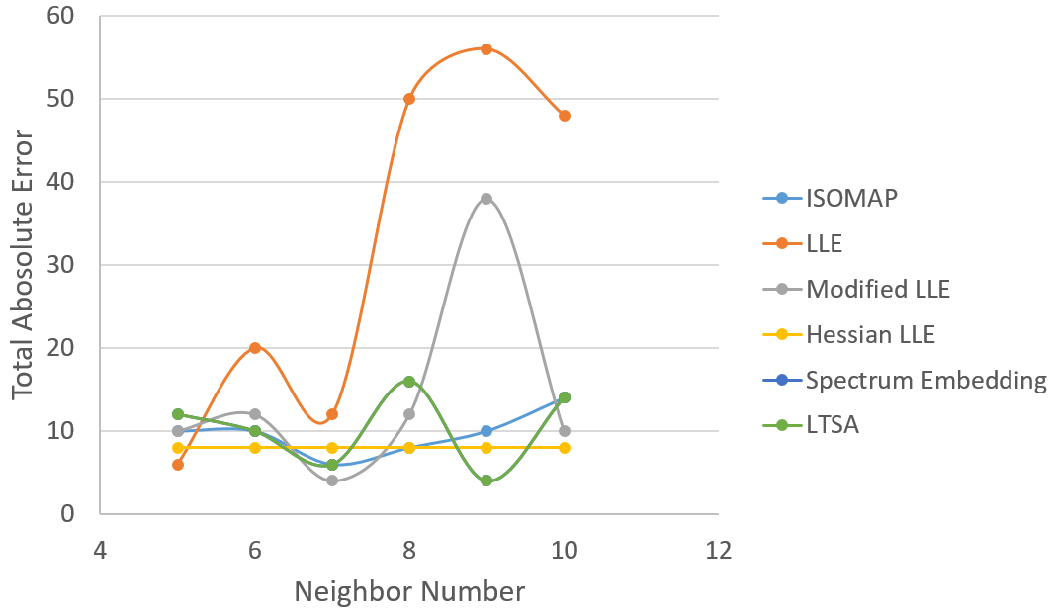
Parameter Study
Parameter Study on the neighbor number (k)
Spectral Embedding with different number of neighbors

Slide 12
Conclusion and Further Work
Conclusion
Further Work
All the methods we explored show reasonable sorting order except t-SNE.
LLE exhibits the lowest TAE performs best.
Parameter study was performed on the number of nearest neighbour k and 5 proved to be the best, when number of component is 2.
Apply these methods into a more complicated dataset. (e.g. head images with both turning and nodding motion).
By adding one degree of freedom, more eigenvectors may be involved in deciding the order.
More techniques can be combined with the methods in this report to achieve state-of-art results.

Slide 13
Reference
[1] Ji, Qiang. 3D face pose estimation and tracking from a monocular camera, Image and vision computing, 20.7 (2002): 499-511.
[2] G. Young and A. S. Householder, A note on multidimensional psycho-physical analysis, Psychometrika6 (1941), 331–333.
[3] David L. Donoho and Carrie Grimes. Hessian eigenmaps: Locally linear embedding techniques for high dimensional data, Proceedings of the National Academy of Sciences of the United States of America 100(2003), no. 10, 5591-5596.
[4] https://github.com/yao-lab/yao-lab.github.io/blob/master/data/isomapII.m
[5] https://github.com/yao-lab/yao-lab.github.io/blob/master/data/lle.m
[6] Pedregosa et al., Scikit-learn: Machine Learning in Python, JMLR 12, pp. 2825-2830, 2011.
Contributions
Di LIU: code in Matlab (Diffusion map, MDS, ISOMAP, LLE), ground truth collection and performance metrics decision, result organization, report (4.1, 4.2 and 5), ppt & presentation.
Meilan WANG: code in Python (8 methods, hyper-parameter test and performance evaluation), report (abstract, 1, 2, 3.5, 3.6, 4.2 and 4.3), ppt & presentation.
Xu HAN: code in Python (6 methods), report (3 (exclude 3.5, 3.6) and 4.3, proofreading and format modifying)

Slide 14
Thanks!

